Slide 1

Make it faster, you can!
Angular packed guide for optimisation

Slide 2




@About({speaker: ’Petros Melachroinidis’})
Senior software engineer @ NTT DATA
Web Development Instructor @ SAE
Co-Organizer Angular Athens Meetup
petrosmel

Slide 3
Today’s talk
Why speed matters
Use cases and techniques
Tools
QnA

Slide 4

Why speed matters?

Slide 5
main.js
Notes:
Talk about chunks and initial big main.js / bundle file

Slide 6





Why speed really matters
User Experience – Initial load - TTFB
Convention rate
Mobile Performance – Bandwidth
SEO – Speed is a ranking factor
Server overload – Save resources
Accessibility
NBU (Next-Billion-Users)
Notes:
1. UX – Initial load [example with late page]
2. Convention rate explain
3. Mobile plan limits and speed
4. SEO speed ranking
5. Save Economy
6.

Slide 7
NBU (Next-Billion-Users)
Rank | Country / Territory | Unconnected People | % of Population
1 | India | 685,591,071 | 50%
2 | China | 582,063,733 | 41%
3 | Pakistan | 142,347,735 | 65%
4 | Nigeria | 118,059,925 | 58%
5 | Bangladesh | 97,427,352 | 59%
6 | Indonesia | 96,709,226 | 36%
7 | Ethiopia | 92,385,728 | 81%
8 | Democratic Republic of Congo | 71,823,319 | 81%
9 | Brazil | 61,423,295 | 29%
10 | Egypt | 46,626,170 | 46%
Notes:
1. UX – Initial load [example with late page]
2. Convention rate explain
3. Mobile plan limits and speed
4. SEO speed ranking
5. Save Economy
6.

Slide 8
How?
Code splitting
Runtime optimization

Slide 9
Lazy loading with Routing
Notes:
Talk about chunks and initial big main.js / bundle file

Slide 10
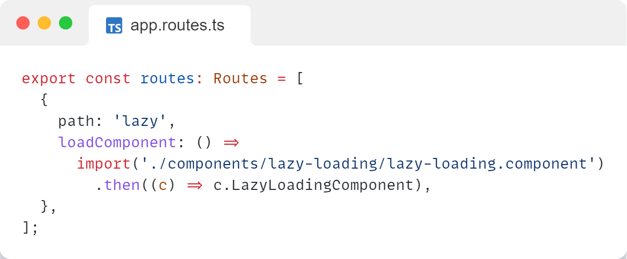
Lazy loading
Notes:
Talk about chunks and initial big main.js / bundle file

Slide 11
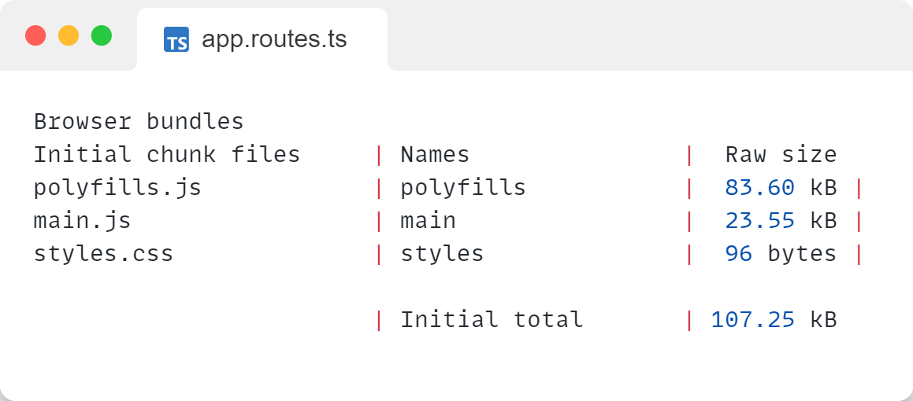
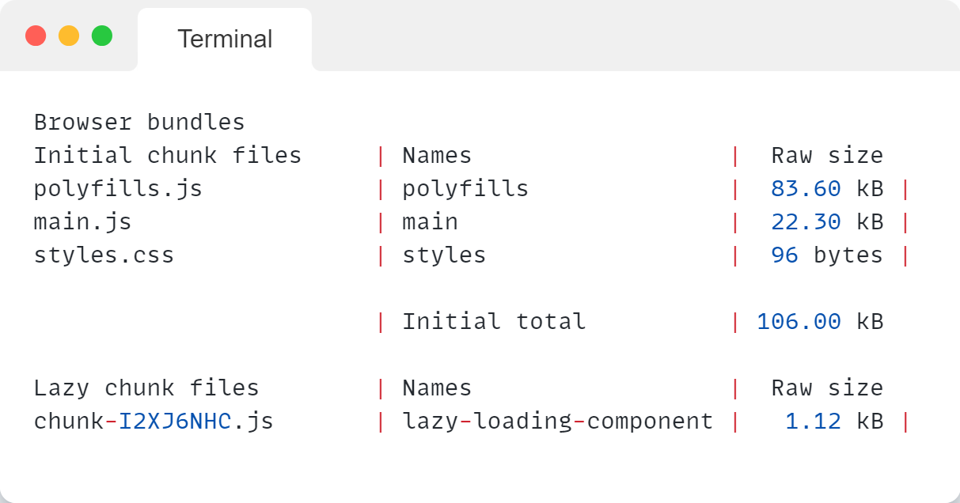
Lazy loading
Notes:
Talk about chunks and initial big main.js / bundle file

Slide 12
Give me more code splitting
Notes:
Talk about chunks and initial big main.js / bundle file

Slide 13
Dynamic Components
@ViewChild
ViewContainerRef
Notes:
UX – Initial load [example with late page]
Convention rate the lower the better Conversion Rate=(Number of VisitorsNumber of Conversions​)×100%

Slide 14
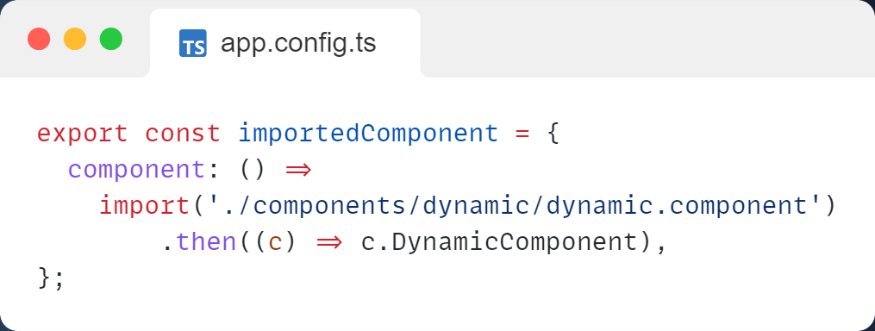
Dynamic Components
Notes:
UX – Initial load [example with late page]
Convention rate the lower the better Conversion Rate=(Number of VisitorsNumber of Conversions​)×100%

Slide 15
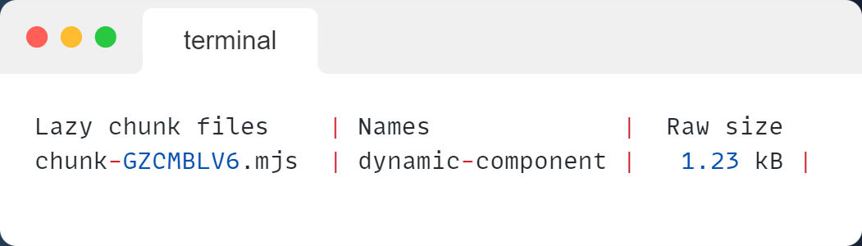
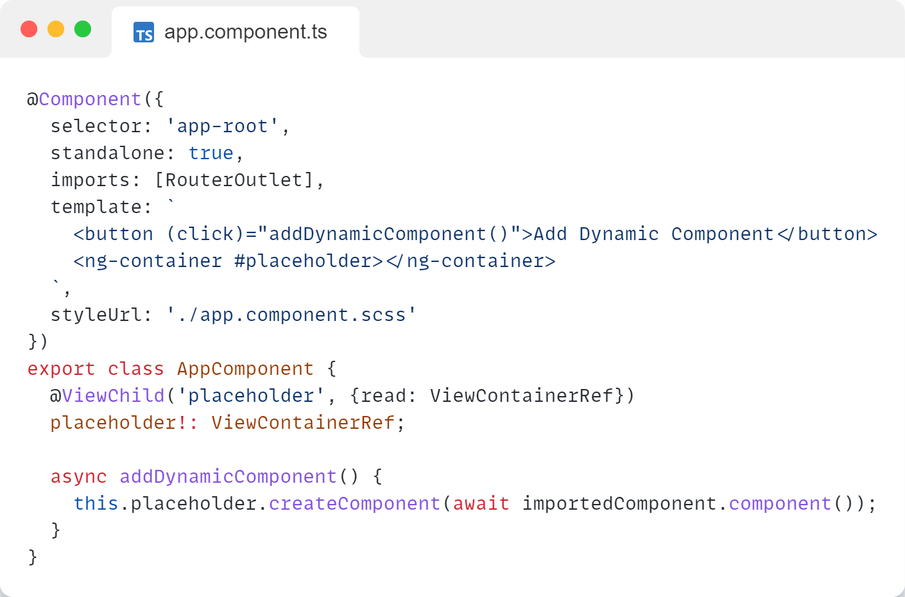
Dynamic Components
Notes:
UX – Initial load [example with late page]
Convention rate the lower the better Conversion Rate=(Number of VisitorsNumber of Conversions​)×100%

Slide 16
Easier way?
Notes:
Talk about chunks and initial big main.js / bundle file

Slide 17
Deferable views
Notes:
Talk about chunks and initial big main.js / bundle file

Slide 18
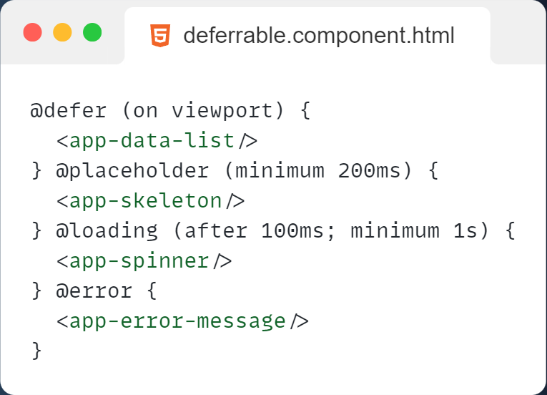
on
idle
viewport
interaction
hover
immediate
timer
when boolean
Notes:
UX – Initial load [example with late page]
Convention rate the lower the better Conversion Rate=(Number of VisitorsNumber of Conversions​)×100%

Slide 19
What about runtime optimization?
Notes:
Talk about chunks and initial big main.js / bundle file

Slide 20
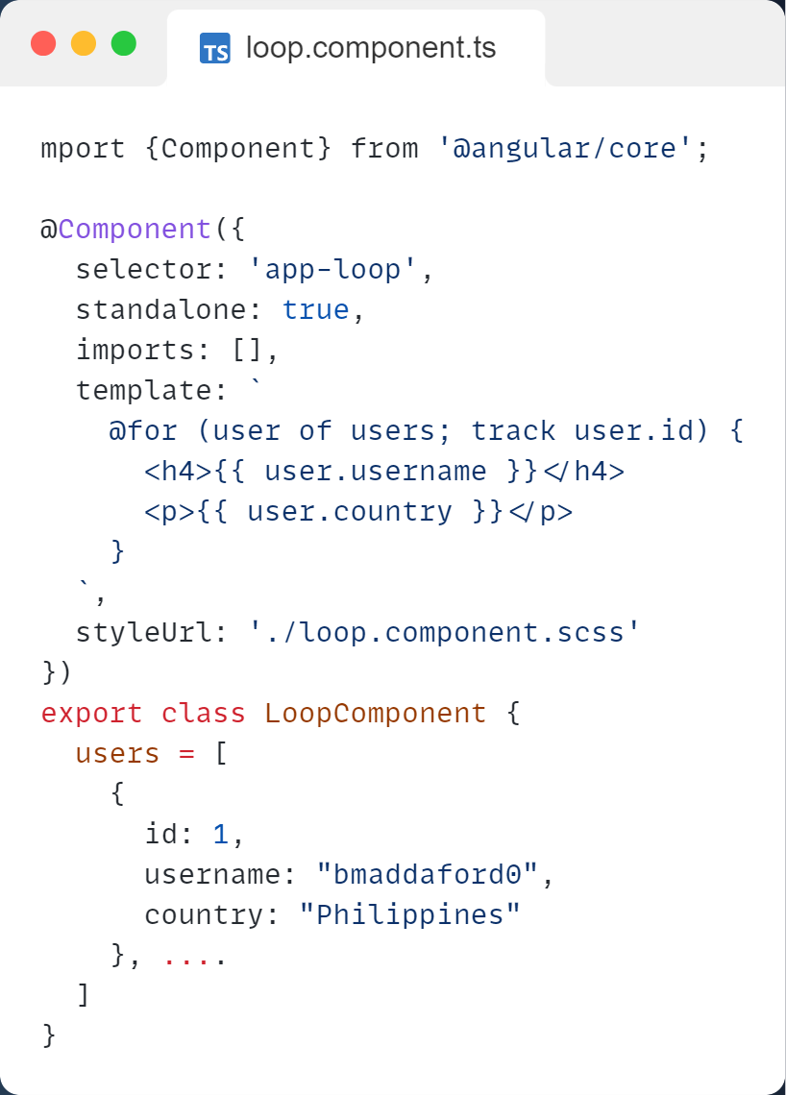
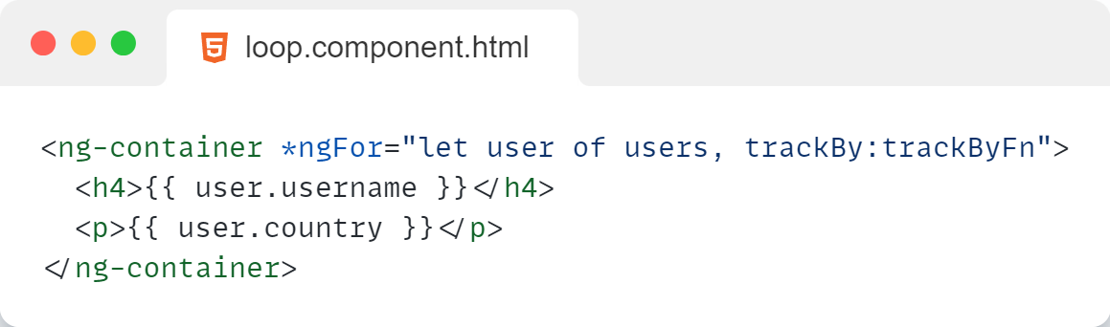
@for
Up to 90% faster than ngFor
trackBy is mandatory
Notes:
UX – Initial load [example with late page]
Convention rate the lower the better Conversion Rate=(Number of VisitorsNumber of Conversions​)×100%

Slide 21
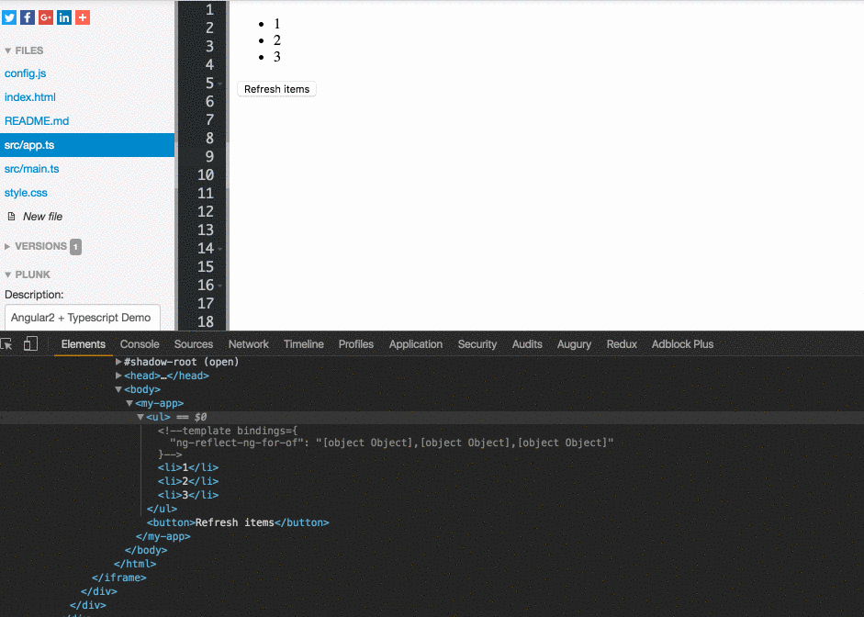
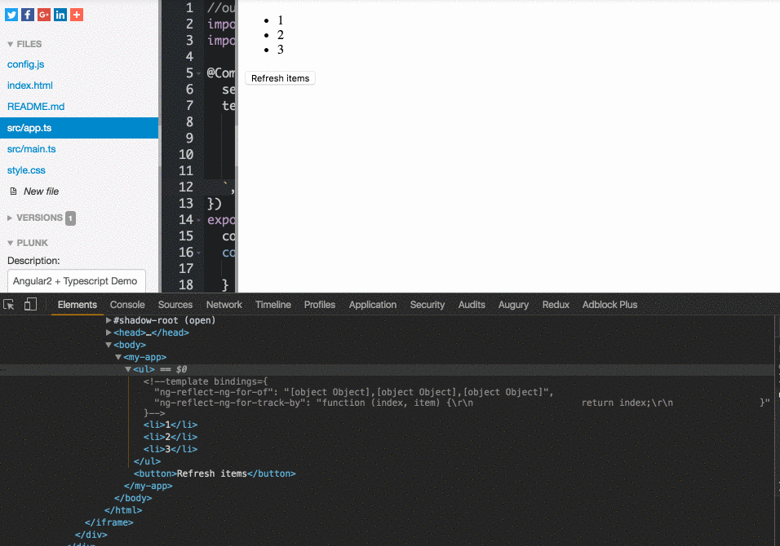
without trackBy
with trackBy
Notes:
UX – Initial load [example with late page]
Convention rate the lower the better Conversion Rate=(Number of VisitorsNumber of Conversions​)×100%

Slide 22
Change detection and component tree
Notes:
Talk about chunks and initial big main.js / bundle file

Slide 23
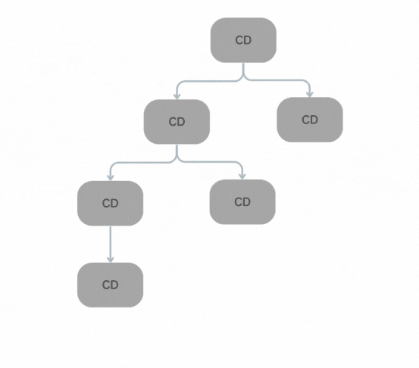
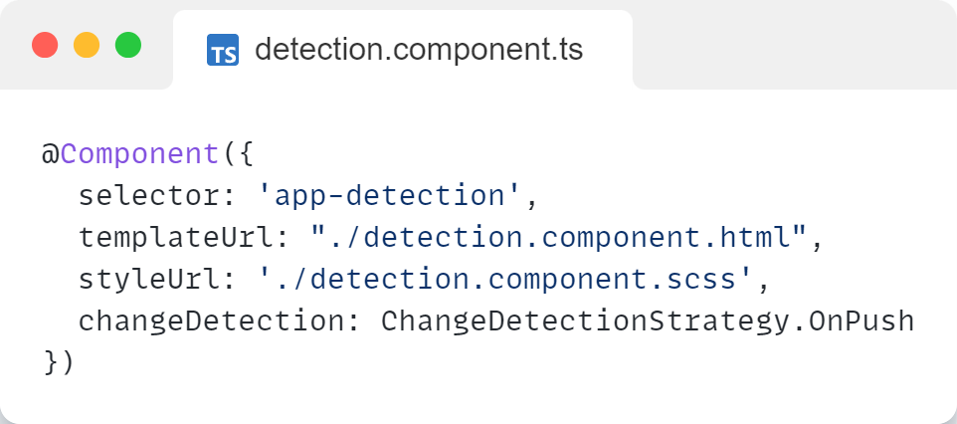
Change detection and component tree
Notes:
UX – Initial load [example with late page]
Convention rate the lower the better Conversion Rate=(Number of VisitorsNumber of Conversions​)×100%

Slide 24
Pure Pipes
Notes:
Talk about chunks and initial big main.js / bundle file

Slide 25
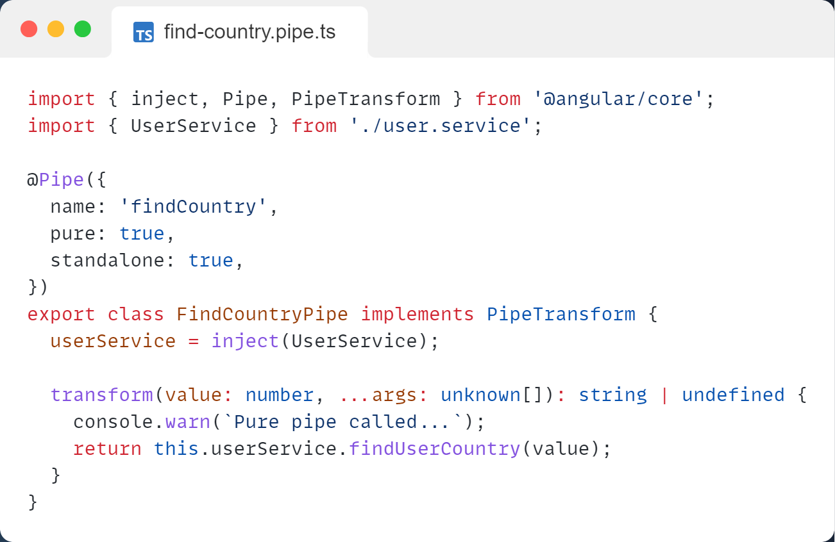
Notes:
UX – Initial load [example with late page]
Convention rate the lower the better Conversion Rate=(Number of VisitorsNumber of Conversions​)×100%

Slide 26
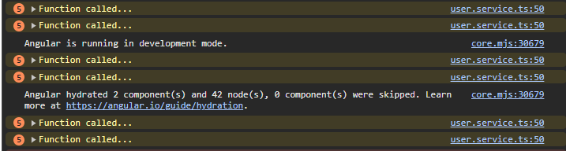
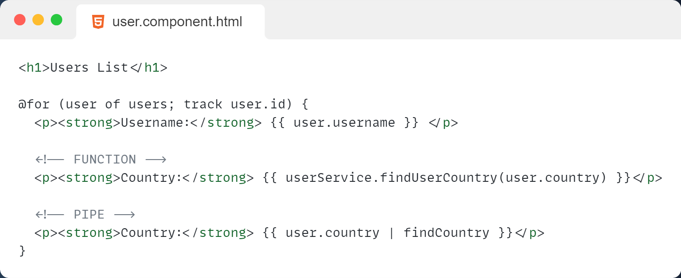
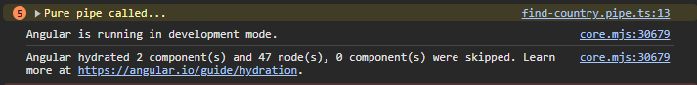
Notes:
UX – Initial load [example with late page]
Convention rate the lower the better Conversion Rate=(Number of VisitorsNumber of Conversions​)×100%

Slide 27
Same behavior in component.ts?
Notes:
Talk about chunks and initial big main.js / bundle file

Slide 28
Memoization
Notes:
Talk about chunks and initial big main.js / bundle file

Slide 29
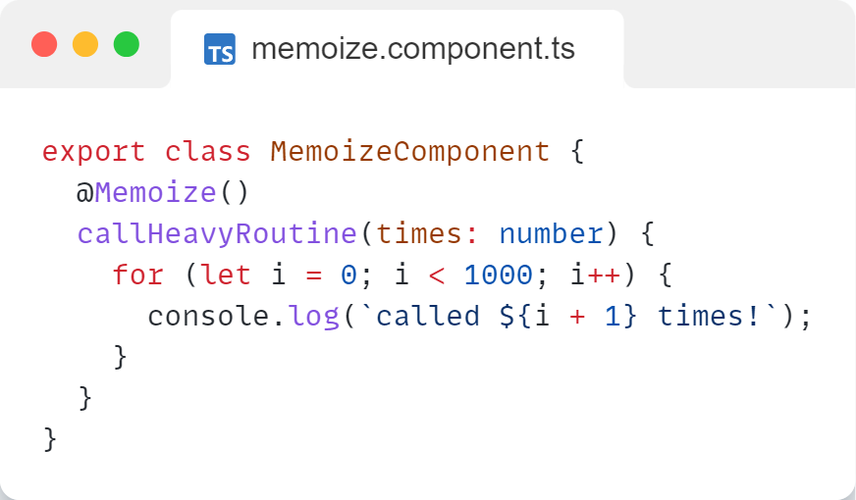
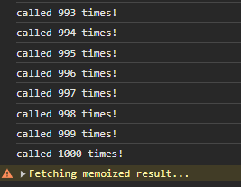
Memoization
Notes:
UX – Initial load [example with late page]
Convention rate the lower the better Conversion Rate=(Number of VisitorsNumber of Conversions​)×100%

Slide 30
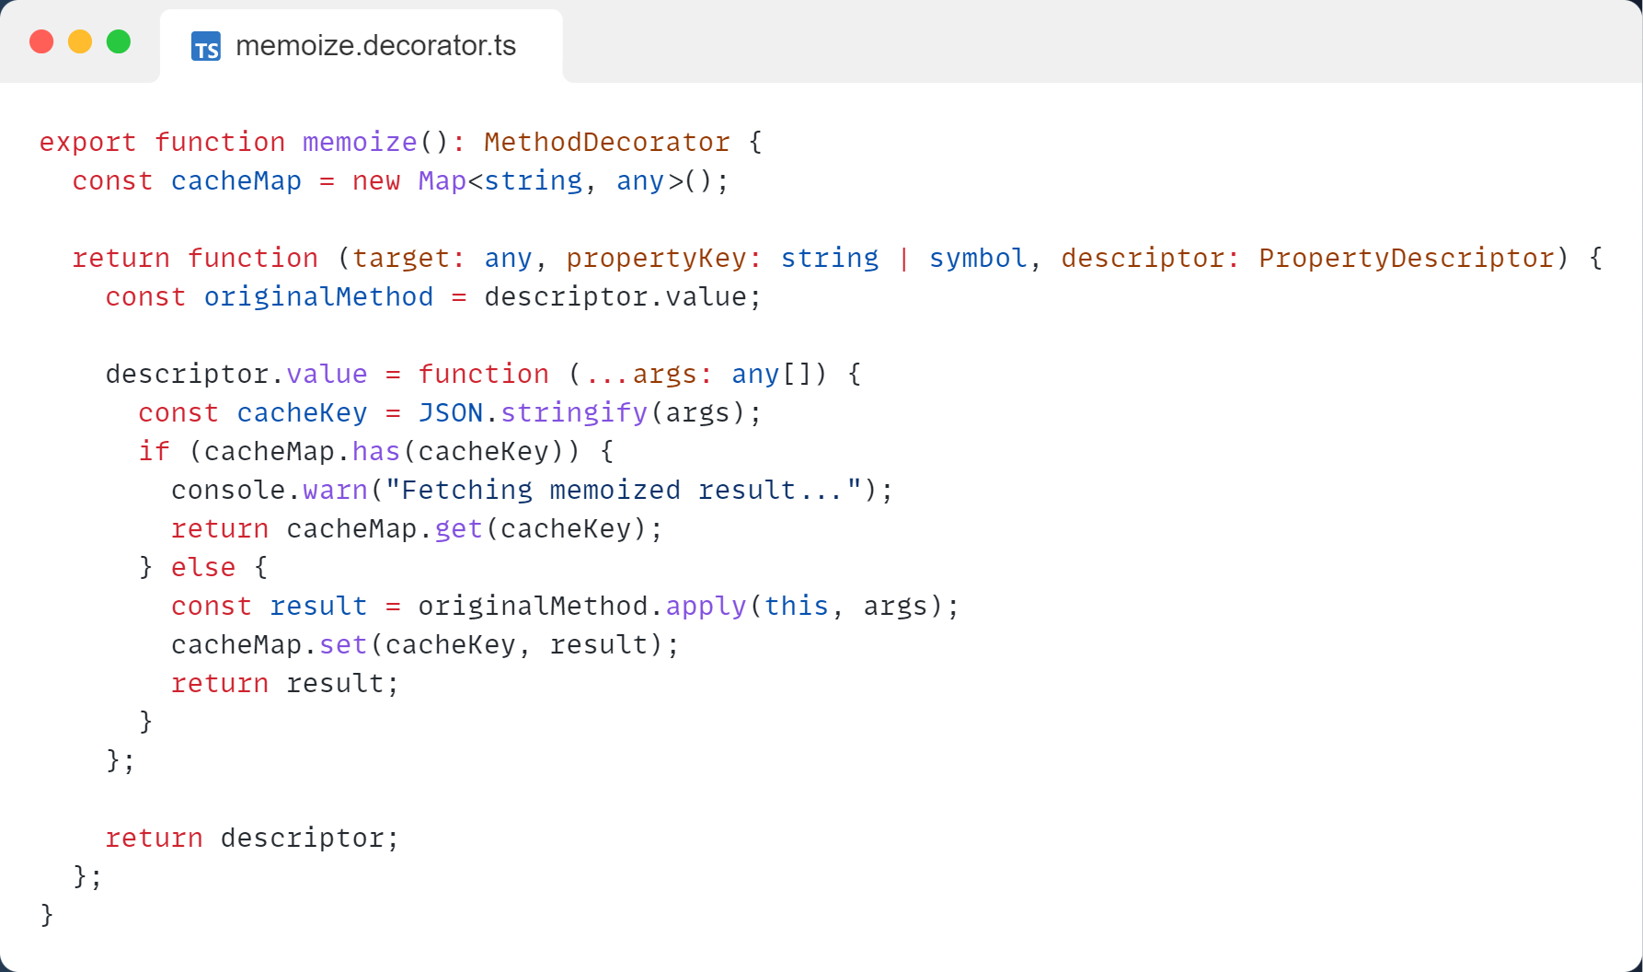
Memoization
Notes:
UX – Initial load [example with late page]
Convention rate the lower the better Conversion Rate=(Number of VisitorsNumber of Conversions​)×100%

Slide 31
Images Lazy loading
Notes:
Talk about chunks and initial big main.js / bundle file

Slide 32
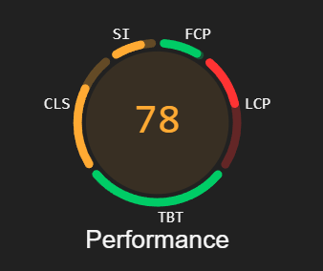
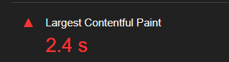
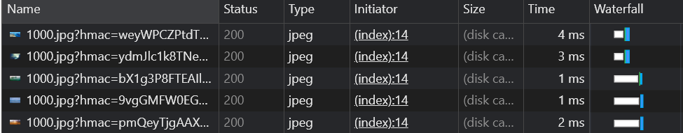
Images Lazy loading
Notes:
UX – Initial load [example with late page]
Convention rate the lower the better Conversion Rate=(Number of VisitorsNumber of Conversions​)×100%

Slide 33
[src] => [ngSrc]
Notes:
UX – Initial load [example with late page]
Convention rate the lower the better Conversion Rate=(Number of VisitorsNumber of Conversions​)×100%

Slide 34
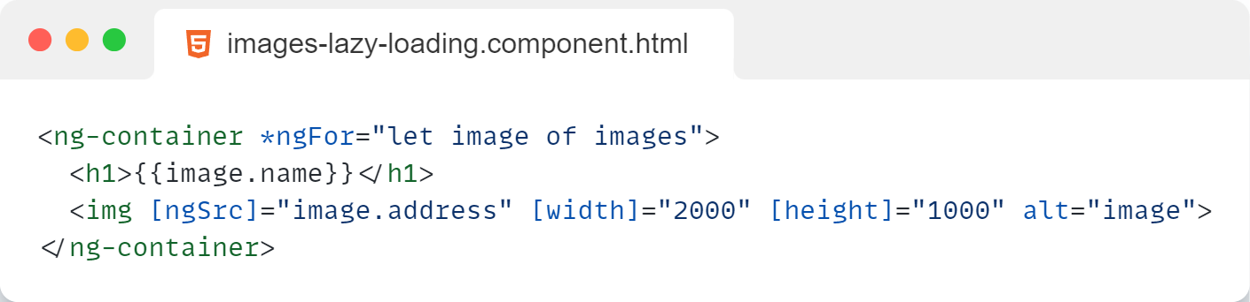
Images Lazy loading
Notes:
UX – Initial load [example with late page]
Convention rate the lower the better Conversion Rate=(Number of VisitorsNumber of Conversions​)×100%

Slide 35
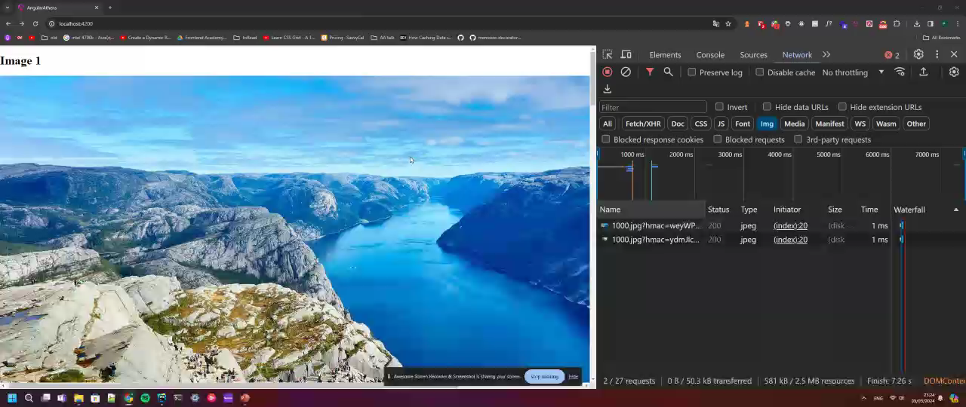
Images Lazy loading
Notes:
UX – Initial load [example with late page]
Convention rate the lower the better Conversion Rate=(Number of VisitorsNumber of Conversions​)×100%

Slide 36
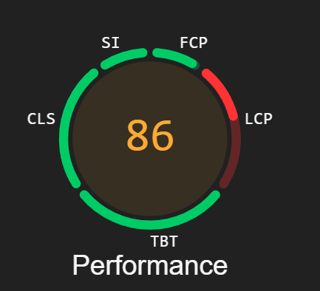
Images Lazy loading
Notes:
UX – Initial load [example with late page]
Convention rate the lower the better Conversion Rate=(Number of VisitorsNumber of Conversions​)×100%

Slide 37
Memory leaks and reactivity handling
Notes:
Talk about chunks and initial big main.js / bundle file

Slide 38
RxJs Operators on duty
take()
takeUntilDestroyed()
debounceTime()
delay()
distinctUntilChanged()
Notes:
UX – Initial load [example with late page]
Convention rate the lower the better Conversion Rate=(Number of VisitorsNumber of Conversions​)×100%

Slide 39
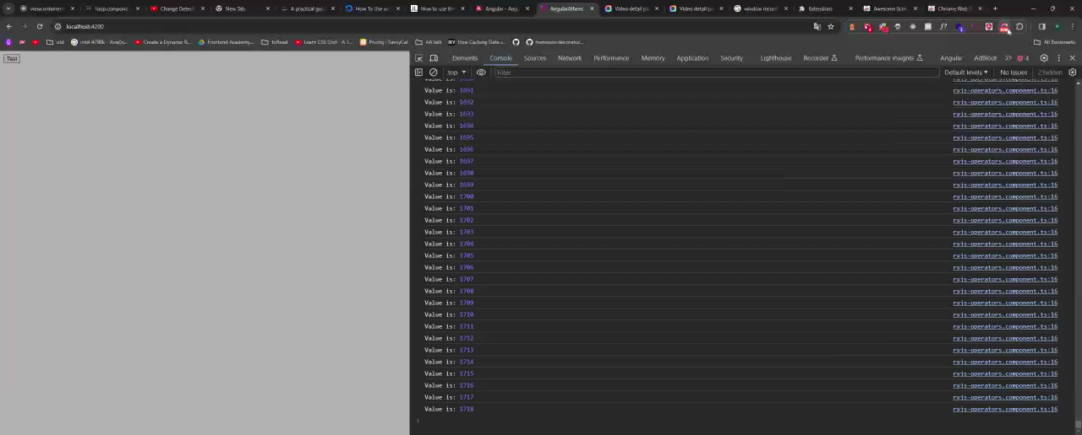
Memory leaks
Component is destroyed…
…but stream is still emitting
Notes:
UX – Initial load [example with late page]
Convention rate the lower the better Conversion Rate=(Number of VisitorsNumber of Conversions​)×100%

Slide 40
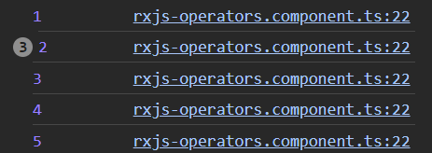
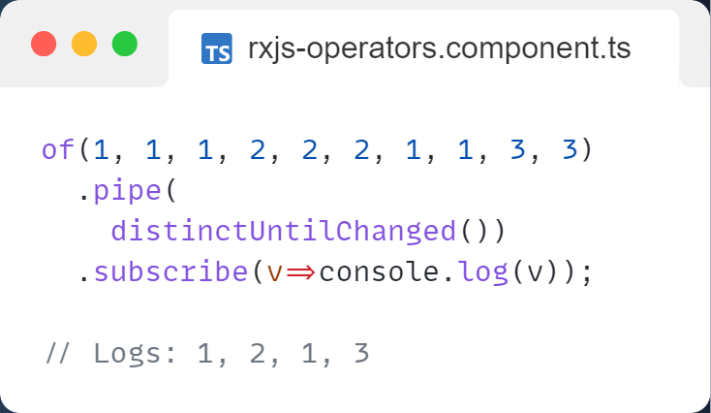
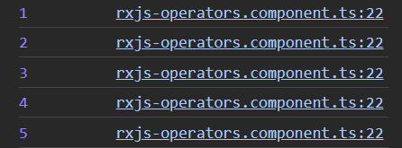
Memory leaks and reactivity handling
Notes:
UX – Initial load [example with late page]
Convention rate the lower the better Conversion Rate=(Number of VisitorsNumber of Conversions​)×100%

Slide 41
Tools
Notes:
Talk about chunks and initial big main.js / bundle file

Slide 42
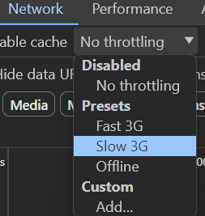
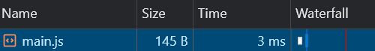
Network Dev tools
Notes:
UX – Initial load [example with late page]
Convention rate the lower the better Conversion Rate=(Number of VisitorsNumber of Conversions​)×100%

Slide 43
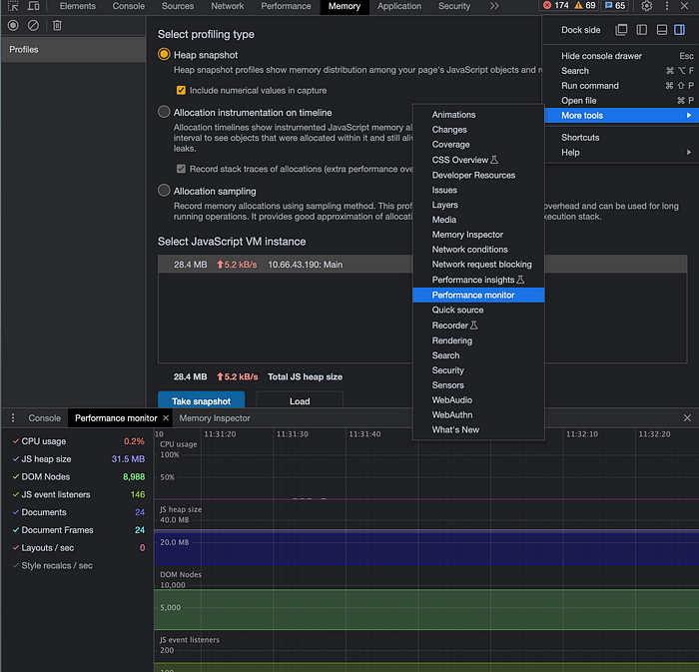
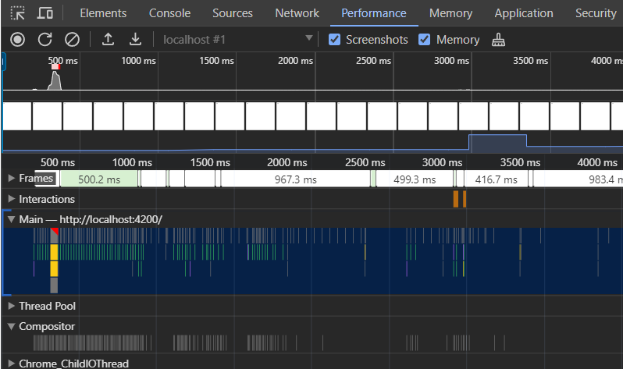
Performance & Memory
memory leak smell…
Notes:
UX – Initial load [example with late page]
Convention rate the lower the better Conversion Rate=(Number of VisitorsNumber of Conversions​)×100%

Slide 44
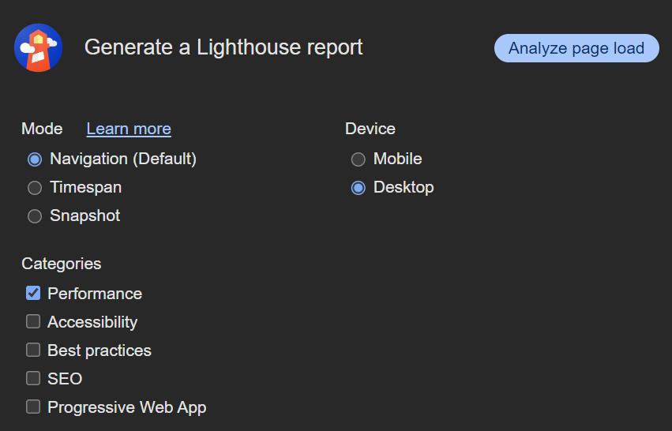
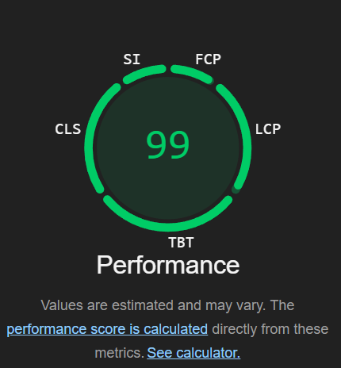
Lighthouse
Notes:
UX – Initial load [example with late page]
Convention rate the lower the better Conversion Rate=(Number of VisitorsNumber of Conversions​)×100%

Slide 45

Angular Dev Tools
Notes:
UX – Initial load [example with late page]
Convention rate the lower the better Conversion Rate=(Number of VisitorsNumber of Conversions​)×100%

Slide 46
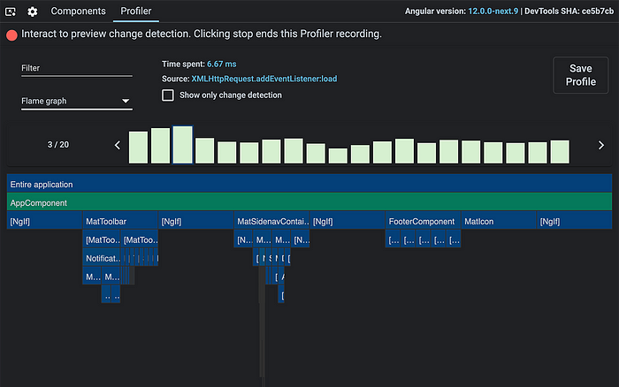
Angular Dev Tools
Notes:
UX – Initial load [example with late page]
Convention rate the lower the better Conversion Rate=(Number of VisitorsNumber of Conversions​)×100%

Slide 47
Dependency management
Do you really need it?
Is it used?
Is it up to date?
Notes:
UX – Initial load [example with late page]
Convention rate the lower the better Conversion Rate=(Number of VisitorsNumber of Conversions​)×100%

Slide 48
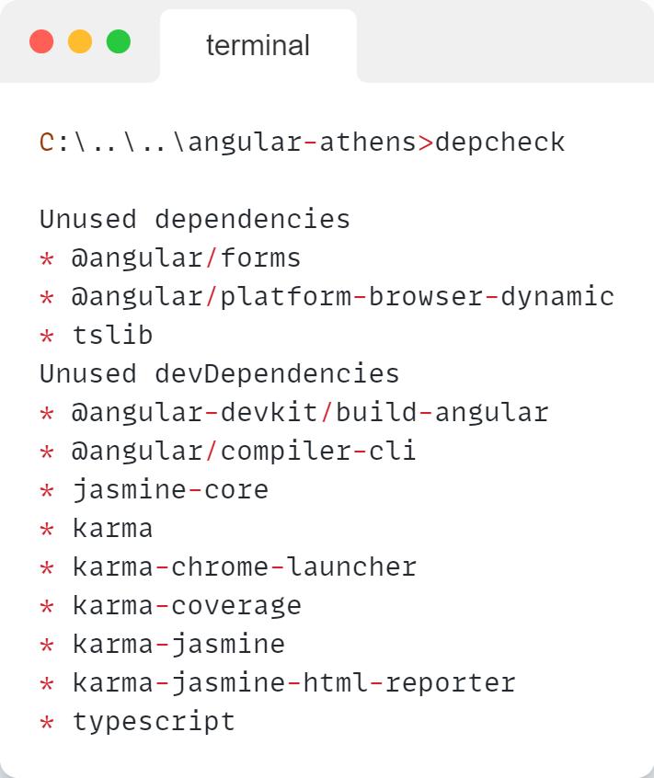
Dependency management
npm i -D depcheck
npm i -D dependency-cruiser
Notes:
UX – Initial load [example with late page]
Convention rate the lower the better Conversion Rate=(Number of VisitorsNumber of Conversions​)×100%

Slide 49
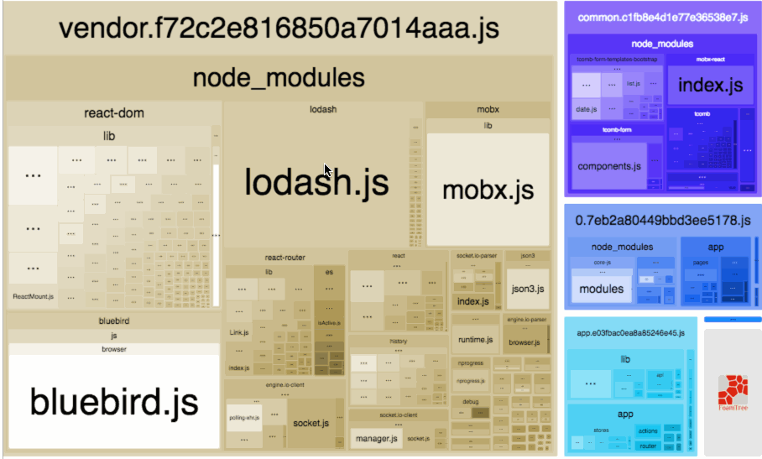
Bundle Analysis
npm i -D webpack-bundle-analyzer
Notes:
UX – Initial load [example with late page]
Convention rate the lower the better Conversion Rate=(Number of VisitorsNumber of Conversions​)×100%

Slide 50
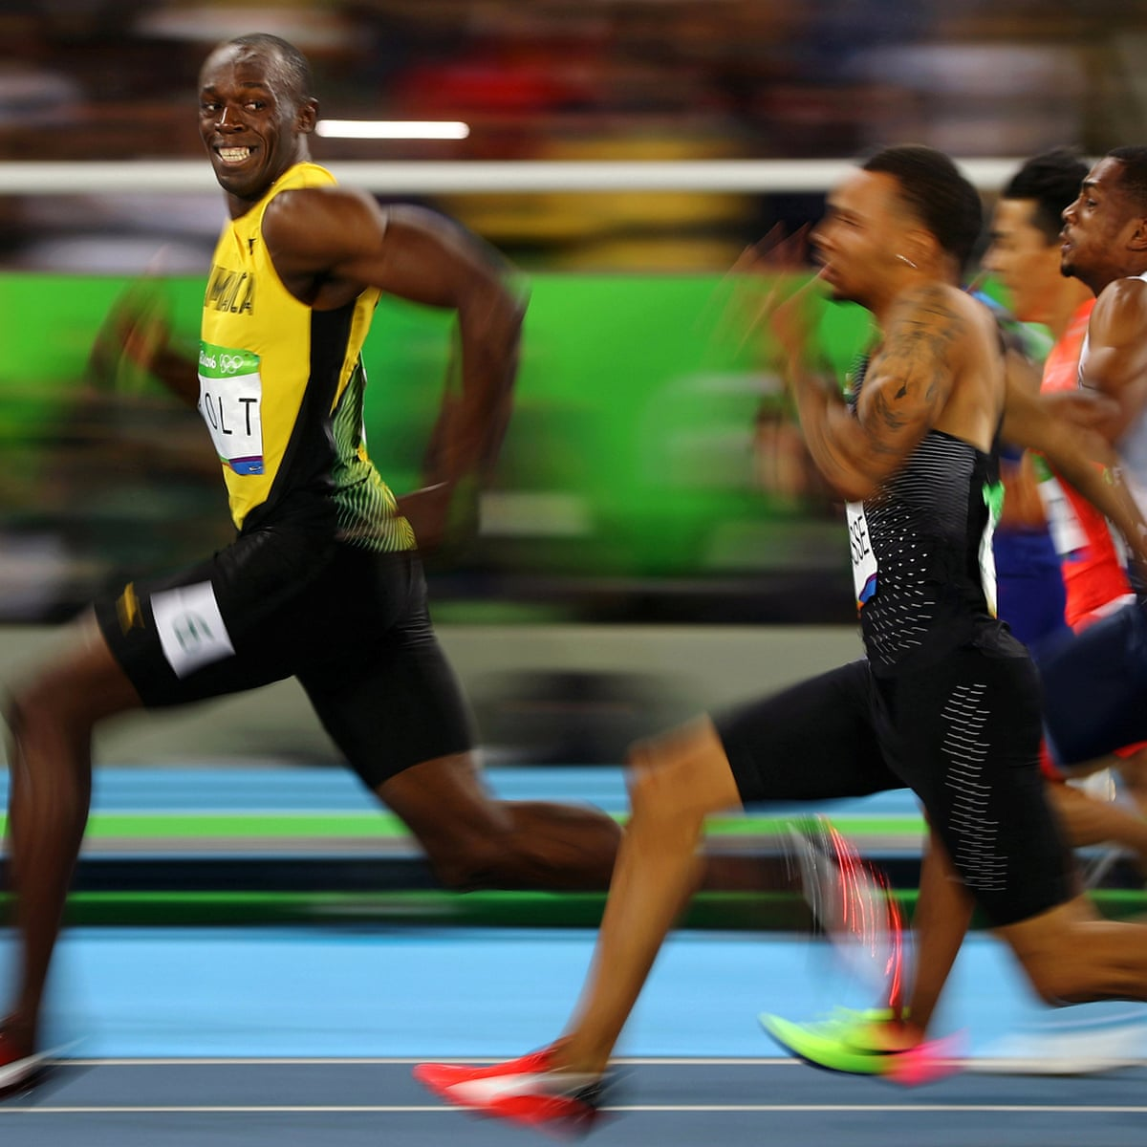
Summing up!
DAMN I AM FAST
Code splitting techniques
Best runtime practices
Use of available tools
Notes:
UX – Initial load [example with late page]
Convention rate the lower the better Conversion Rate=(Number of VisitorsNumber of Conversions​)×100%

Slide 51

Thank you!
petrosmel
github.com
petrosmel/angular-athens

